Slide 1

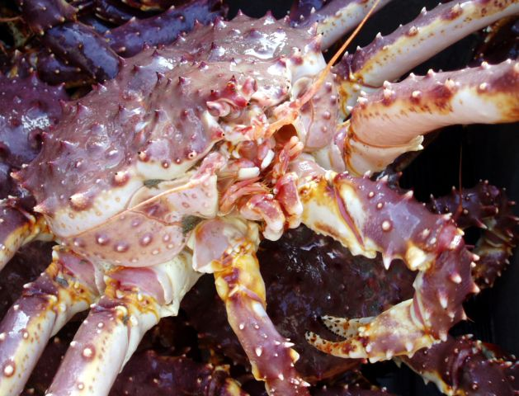
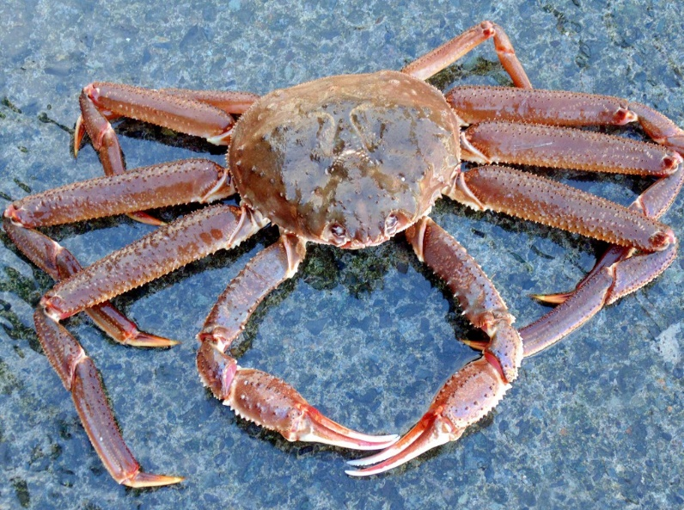
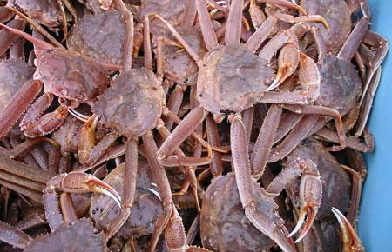
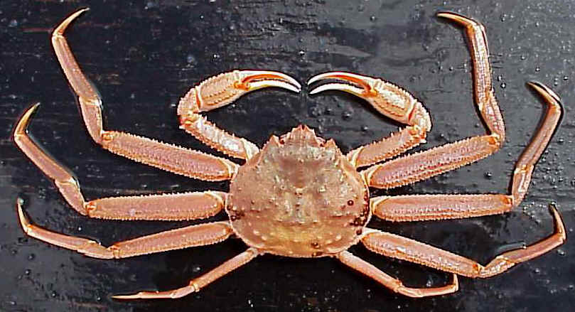

Size-weight modeling refinements for EBS crab stocks: May 2021 update
Jonathan Richar
Jon.richar@noaa.gov
Alaska Fisheries Science Center
Kodiak Laboratory
Notes:
Good morning everyone, and welcome to my update to the length-weight modeling analyses that were presented in January.

Slide 2
Refresher
Update model parameters used to calculate biomass estimates based on size-weight relationships
Allowing for factors affecting the relationships that were not accounted for in work that developed currently used parameters (Chilton 2009, 2011)
Red king crab, tanner crab, opilio crab
Shell condition
Red king crab only
Thermal regime of given survey year
Notes:
As a quick refresher, the work being presented was done as part of an effort to evaluate whether it would be appropriate to update the model parameters used to calculate weights based on individual crab size, as the models used to calculate the currently used parameters did not account for factors that might influence the crab size-weight relationships.
In the work presented in January the potential for shell condition to affect the length-weight relationship for male BBRKC, opilio and bairdi was investigated, while for male BBRKC only, temperature was evaluated.

Slide 3
Refresher 2
 | N
Male BBRKC - NS | 1756
Male BBRKC - OS | 552
Male BBRKC - NS - cold | 1265
Male BBRKC - NS - warm | 491
Male Tanner crab - NS | 3314
Male Tanner crab - OS | 2064
Male Opilio crab - NS | 4531
Male Opilio crab - OS | 1979
Notes:
I had excellent sample sizes

Slide 4
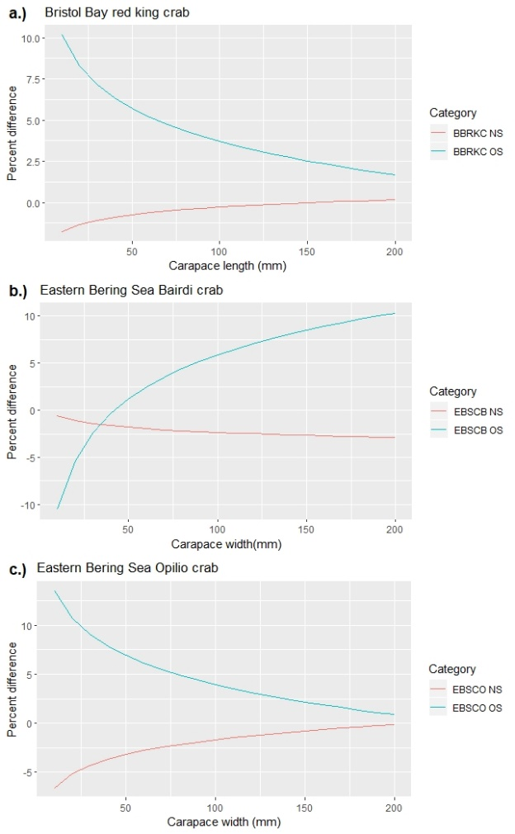
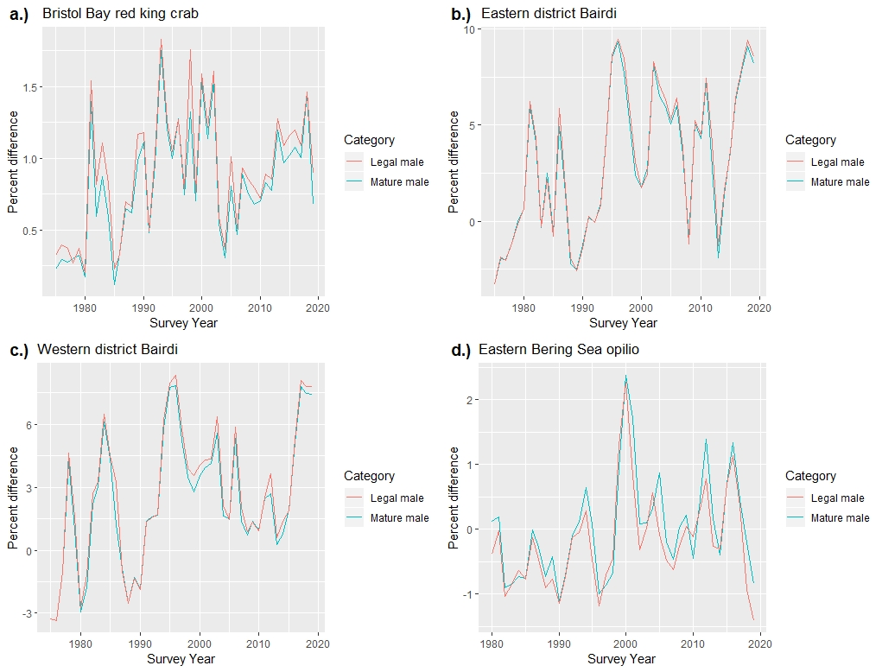
Refresher 3
Notes:
OS and NS models were generally different from each other in terms of slope, intercept, or both.
When the new size-weight parameters were used in the calculation of annual biomass estimates, variable but small deviations from current baseline estimates were observed, with these being greatest in Bairdi.
When the new parameters were used to calculate weight-at-size, it was shown that the currently accepted size-weight models overestimate NS crab weight and underestimate OS crab weight at given sizes, with magnitudes varying across the size ranges investigated, but being greatest at small sizes for red king crab and opilio, and at large sizes in bairdi.

Slide 5
January CPT comments
Apply bias correction methods (Brodziak 2012)
Bias correction procedures implemented for all stocks and will be presented
Provide biological basis for reevaluating size-weight parameters
Chris Long consulted, and biological basis provided
Include Bering Sea blue king crab stocks
St. Matthew Blue King crab included
Include females for major stocks
Females analyzed
Maturity status (requested approach)
Clutch state; immature + barren vs clutch bearing mature (current approach)
Notes:
Following the January presentation the CPT made a number of requests…

Slide 6
January CPT comments
Treat temperature as a continuous variable instead of designating warm/cold years
Working on implementing this
January meeting?
Use all available historical data
Currently used data is from 2000 onwards
Good sample sizes
Only data previous to 2000 is from 1975 (Bairdi and opilio)

Slide 7
Why reevaluate size-weight relationships?
Shell condition influences the size-at-weight relationship
Carapace composition
Tissue fill within carapace
Temperature
Delayed molt timing,
Reduced tissue fill in cold years due to reduced time between molt and sampling
Thermal stress
Models used for current parameters did not account for these (Chilton 2009, 2011)
Biomass estimates may be biased to varying degrees in any given year, due to for example shell condition proportions

Slide 8
Methods

Slide 9
Methods I
Up to date size-weight data
2000 – 2019
Collected randomly on the EBS summer bottom trawl survey
Clean (no/minimal epibionts), intact (no carapace cracks or missing/regenerating limbs)
Weight (g)
Digital scale
Carapace size (CL/CW) to 0.1mm
Vernier caliper (prior to 2016)
Digital caliper (2016 to present)

Slide 10
Methods II
Stock specific data grouped based on variable of interest
Male Bristol Bay red king crab, SMBKC, EBS Bairdi, EBS opilio
Shell condition
Female Bristol Bay red king crab
Maturity and ovigerous state
Shell condition not examined
Female St Matthew blue king crab
Maturity status only
Limited data
Female opilio and Bairdi
Maturity and ovigerous state
Shell condition for mature and ovigerous crab

Slide 11
Methods III
Weight (g) = a *(Carapace size (mm))^{b}
Parameters a and b estimated separately
Iinear regression fitted to log-transformed size-weight data
Parameter a is the intercept in log-scale and log₋₁
Bias corrected as per Brodziak (2012)
Parameter b is the slope
Slopes compared to baseline estimates using t-tests
Biomass estimates calculated using final parameter estimates, and compared to baseline estimates calculated using current parameters

Slide 12
Results

Slide 13
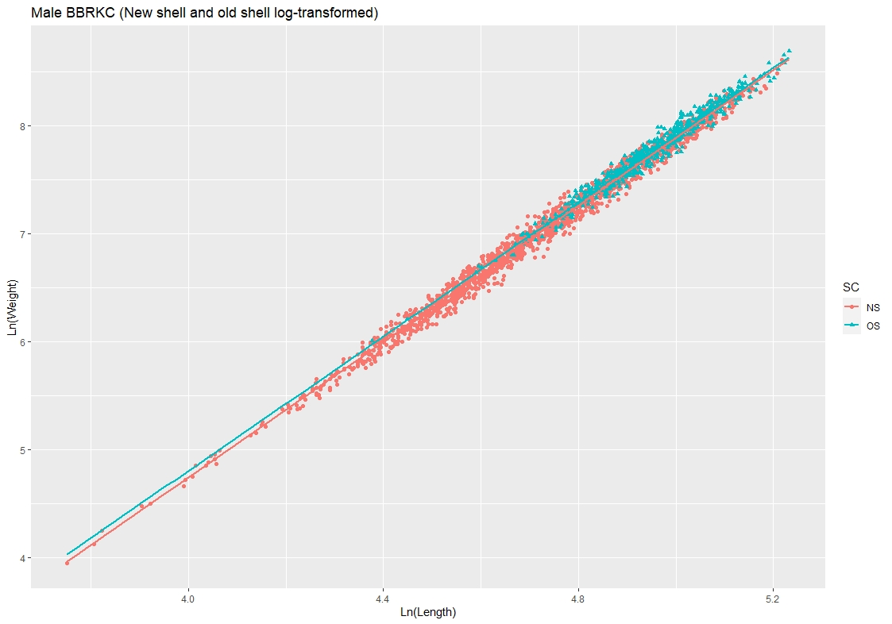
Male red king crab – shell condition
log(W_{OS}) = 0.000481 * CL^{3.111170}
R² = 0.97
Slope not significantly different from baseline
Slopes not different
From each other, though intercepts were
log(W_{NS}) = 0.00039 * CL^{3.147886}
R² = 0.99
Slope not significantly different from baseline
Notes:
For red king crab slopes for both NS and OS models were not significantly different from the baseline model or from each other, though intercepts did differ

Slide 14
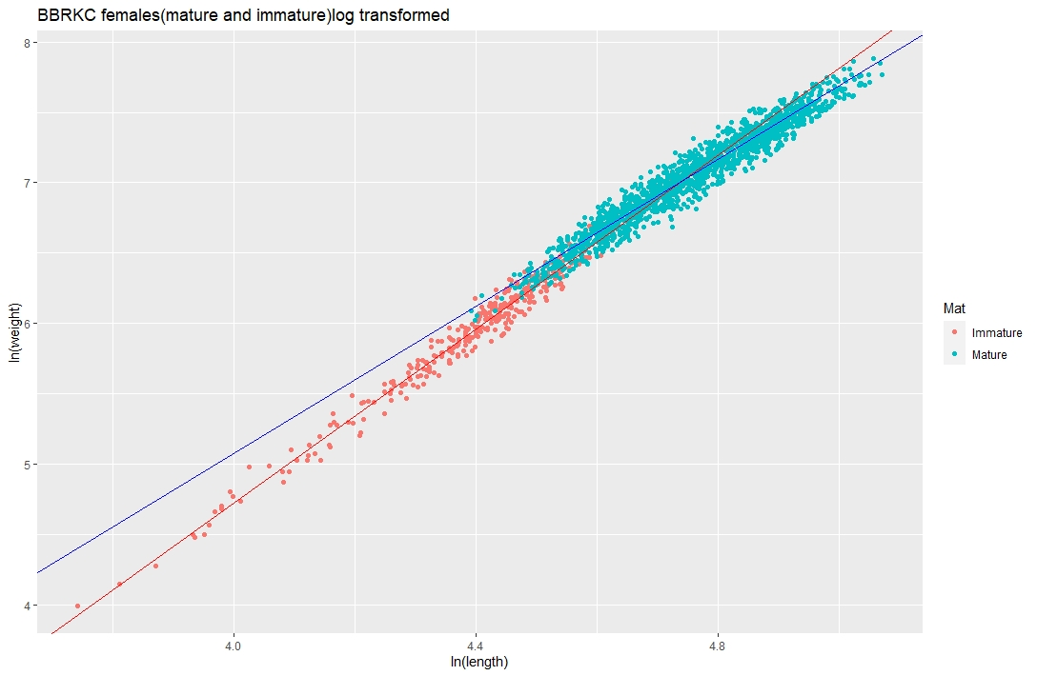
Female red king crab – maturity
Baseline: log(W_{Immat}) = 0.000408 * CL^{3.127956}
Bias corrected: log(W_{Immat}) = 0.000473 * CL^{3.094701}
Slope not significantly different from baseline
Baseline: log(W_{mat}) = 0.000359* CL^{2.666076}
Bias corrected: log(W_{mat}) = 0.000453 * CL^{2.616050}
Slope not significantly different from baseline
Notes:
For red king crab females, while bias-corrected mature and immature female models differed significantly from each other, they did not differ from the current standard model equivalents.

Slide 15
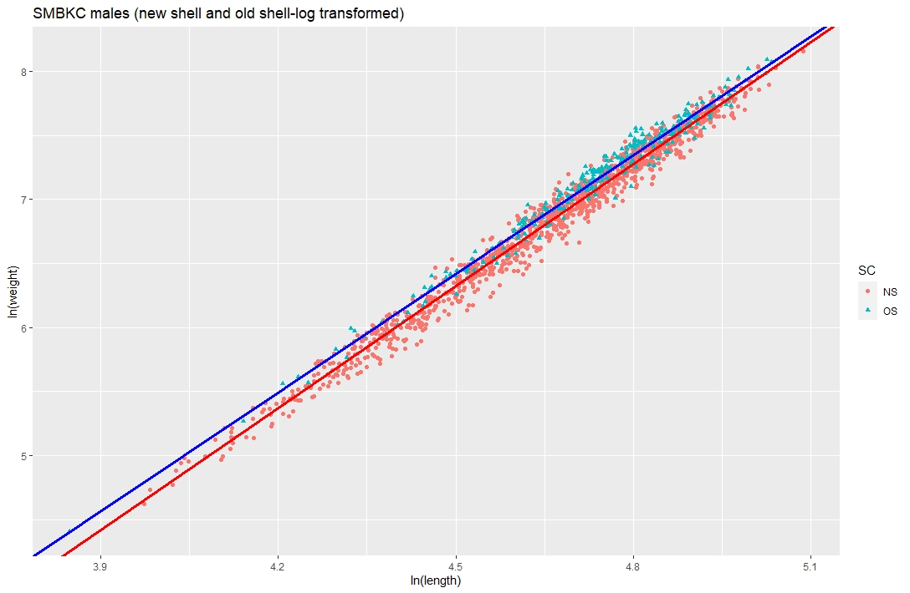
Male SMBKC- shell condition
Baseline: log(W) = 0.000502* CL^{3.107158}
Bias corrected: log(W_{NS}) = 0.000344 * CL^{3.176559}
Slope not significantly different from baseline
Large SE on baseline
Baseline: log(W) = 0.000502* CL^{3.107158}
Bias corrected: log(W_{OS}) = 0.000550 * CL^{3.09395}
Slope not significantly different from baseline
Notes:
The story continues to be the same for SMBKC…

Slide 16
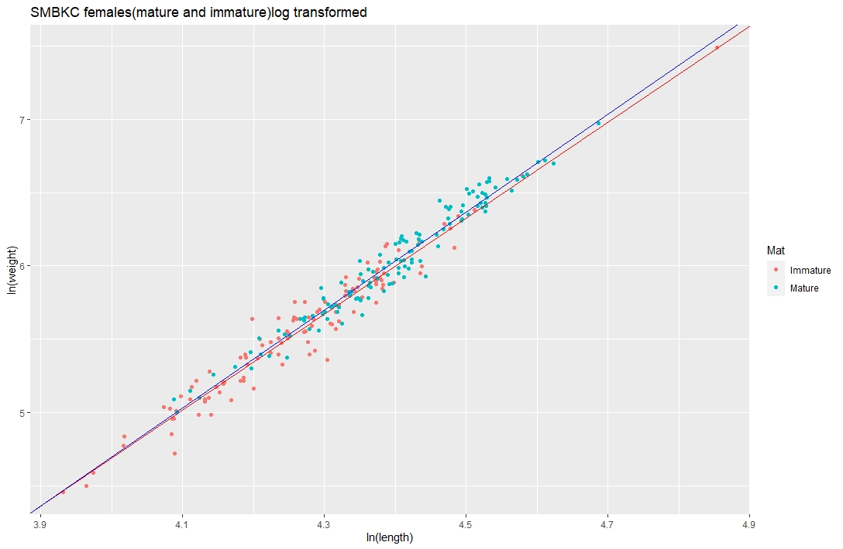
SMBKC females – maturity status
Notes:
While female SMBKC were kind of a SNAFU. I am currently preparing a data request for ADF&G to access to their female data, and hope to be able something better than this in January.

Slide 17
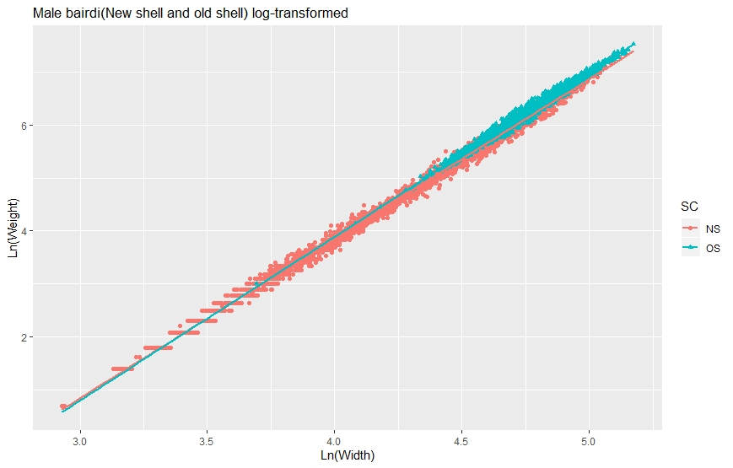
Male Bairdi crab – shell condition
Original: Log(W_{OS}) = 0.000208 * CW^{3.091966}
Bias corrected: Log(W_{OS}) = 0.000208 * CW^{3.091966}
Significantly different from baseline
R² = 0.98
Slopes and intercepts significantly different
Original: Log(W_{NS}) = 0.000273 * CW^{3.014254}
Bias corrected: Log(W_{NS}) = 0.000274 * CW^{3.014254}
Not significantly different from baseline
R² = 0.99
Notes:
For male Bairdi, the OS model was significantly different from both the baseline and the NS model, while the NS model was not statistcaly different from the current baseline.

Slide 18
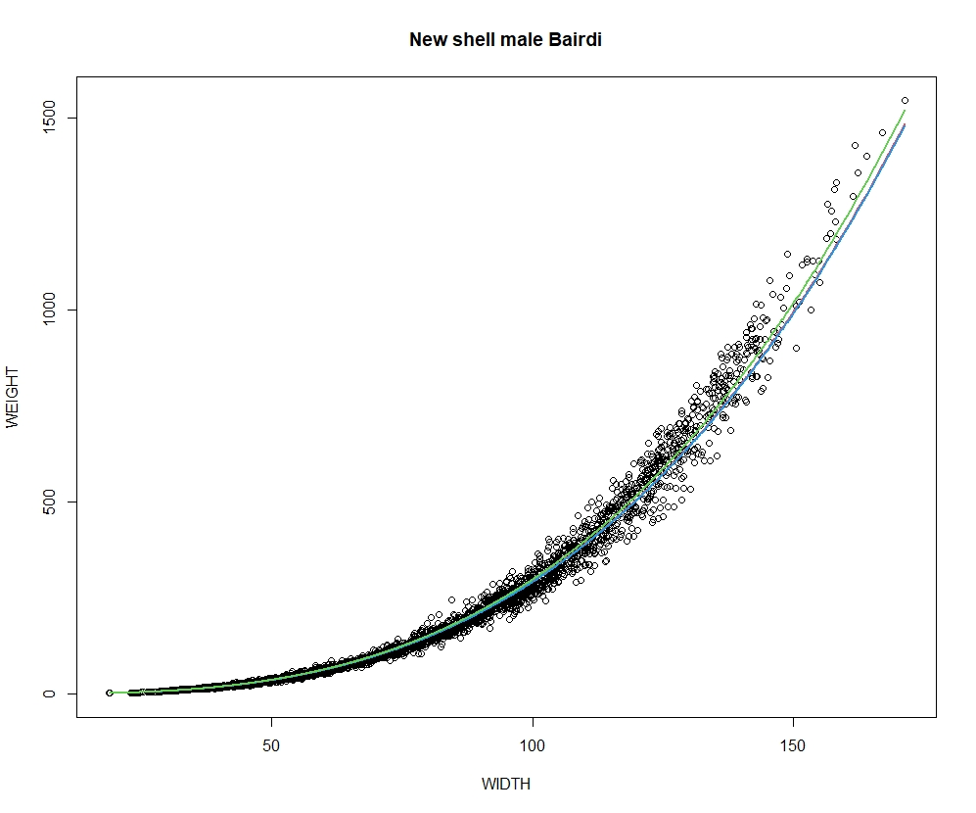
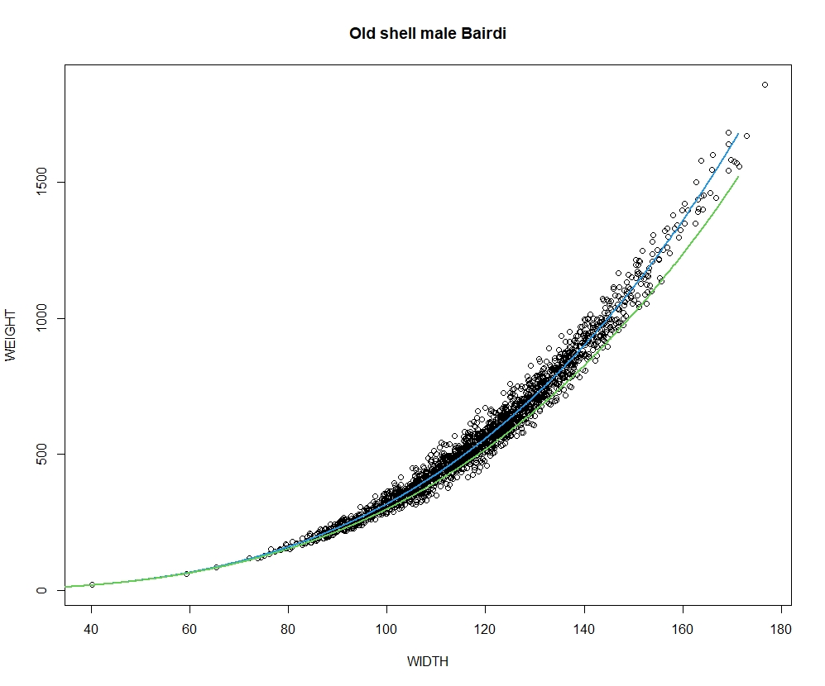
baseline
OS model
baseline
NS model
Notes:
The contrast between the NS and OS models relative to the baseline model is evident when the final size-weight model lines are compared
Here we see that the NS model line is quite similar to the baseline model, whereas the OS model line diverges significantly, and fits the OS male data much better.

Slide 19
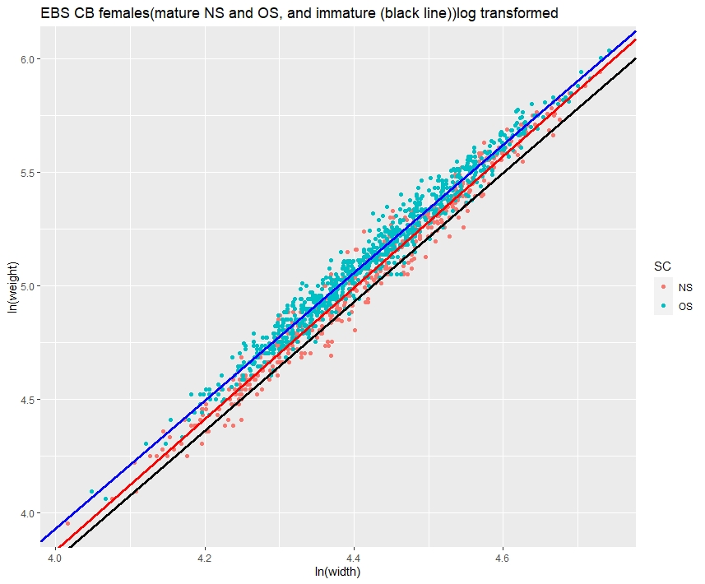
Female Bairdi – maturity/shell condition
Baseline: Log(CW_{Non-ovig}) = 0.00056 * CW^{2.816928}
Baseline: Log(CW_{ovig}) = 0.00044 * CW^{2.898686}
Non-corrected : Log(CW_{immat}) = 0.000508 * CW^{2.844163}
Bias corrected: Log(CW_{Immat}) = 0.00051 * CW^{2.844163}
Not significantly different from baseline
Non-corrected: Log(CW_{NS}) = 0.000425 * CW^{2.89866}
Bias corrected: Log(CW_{NS}) = 0.000426* CW^{2.89866}
Non-corrected: Log(CW_{OS}) = 0.000639 * CW^{2.82084}
Bias corrected: Log(CW_{OS}) = 0.000641 * CW^{2.82084}
OS significantly different from baseline
NS not different
Notes:
As was the case for males, the OS female bairdi model differed from the baseline, while the NS model did not. The immature female model, depicted with the black line here, was not significantly different from the baseline model.
As seen here, bias correction had minimal effect on parameter values, both in these models, and in the others presented here today.

Slide 20
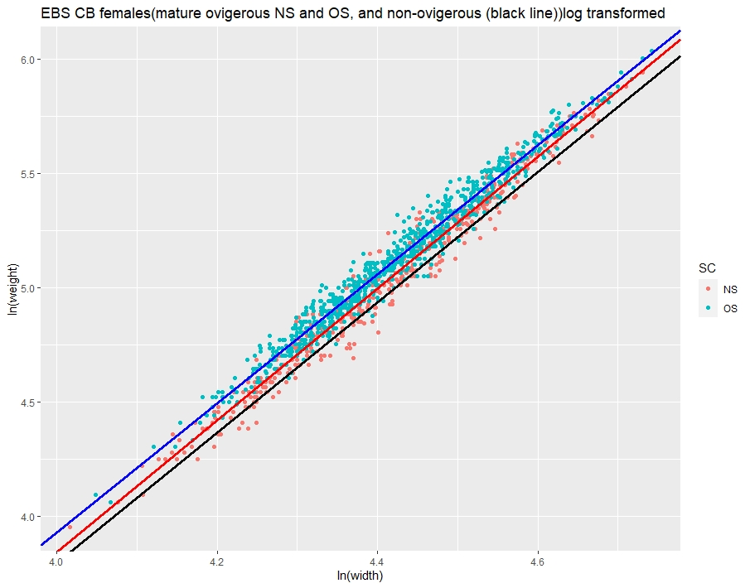
Female Bairdi- maturity/clutch status
Baseline: Log(CW_{non-ovig}) = 0.00056 * CW^{2.816928}
Baseline: Log(CW_{ovig}) = 0.00044 * CW^{2.898686}
Non-corrected : Log(CW_{non-ovig}) = 0.000488 * CW^{2.854783}
Bias corrected: Log(CW_{non-ovig}) = 0.000490 * CW^{2.854783}
Not significantly different from baseline
Non-corrected : Log(CW_{ovigNS}) = 0.000456 * CW^{2.88374}
Bias corrected : Log(CW_{ovigNS}) = 0.000456 * CW^{2.88374}
Non-corrected : Log(Cw_{ovig-OS}) = 0.000631 * CW^{2.824072}
Bias corrected: Log(Cw_{ovig-OS}) = 0.000631 * CW^{2.824072}
Ovig-OS significantly different from baseline
Notes:
Dividing female bairdi into non-ovigerous and ovigerous categories, as was done with the models used to calculate the currently accepted parameters yielded similar results to those seen with the maturity-based models.

Slide 21
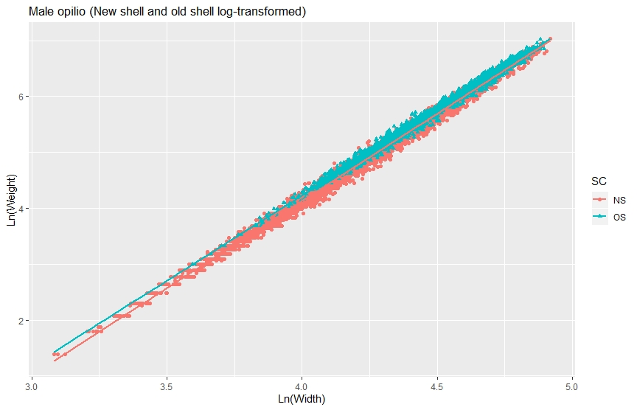
Male opilio crab – shell condition
Non-corrected: Log(CW_{OS}) = 0.000343 * CW^{3.051748}
Bias corrected: Log(CW_{OS}) = 0.000343 * CW^{3.051748}
R² = 0.99
Not significantly different from baseline
Slopes and intercepts significantly different
Non-corrected: Log(CW_{NS}) = 0.000237 * CW^{3.119509}
Bias corrected: Log(CW_{NS}) = 0.000237 * CW^{3.119509}
Not significantly different from baseline
Comparatively large SE for baseline
R² = 0.99
Notes:
Finally, for male opilio crab, while the old shell and new shell differed from each other, neither was significantly different from the baseline model, due largely to the original model’s comparatively large standard error estimate. Bias correction did not have an appreciable effect on parameter values.

Slide 22
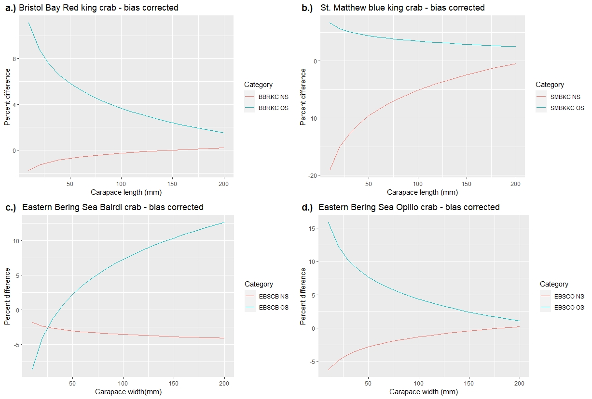
Calculated weight anomalies relative to current models
Notes:
Employing both the standard and new model parameters to calculate weight at size, we can see that relative to the shell-condition based models, the standard model currently used overestimates new shell crab weights, and underestimates old shell crab weights, with the divergences decreasing with crab size for red king cra, blue king crab, and opilio, but increasing with size for Bairdi. These results do not differ appreciably between the original models presented in January, and the bias corrected models.

Slide 23
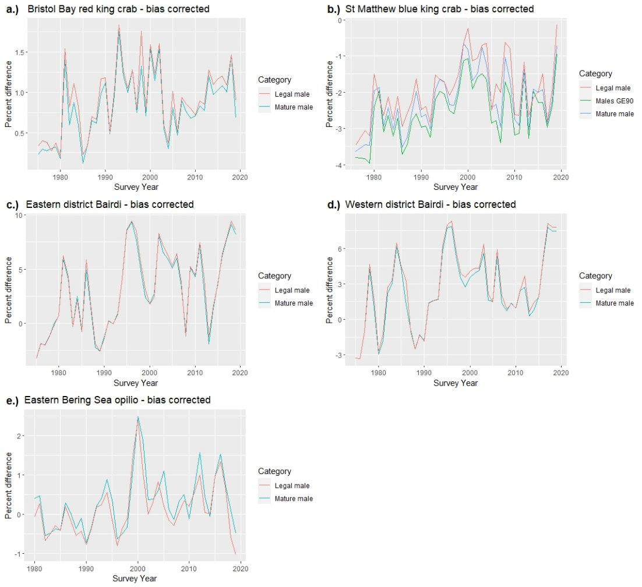
Males
Notes:
Using the new model parameters to calculate biomass estimates, and comparing these to baseline estimates, we see variable but generally minor divergences between the two estimate series for red king crab and opilio. For blue king crab, new-model estimates (those derived from the shell condition based size-weight models) are generally slightly smaller than those calculated using current model parameters. The bairdi shell-condition based models had the largest anomalies from the standard estimates, although magnitudes of the anomalies were variable and generally greater in the eastern district.

Slide 24
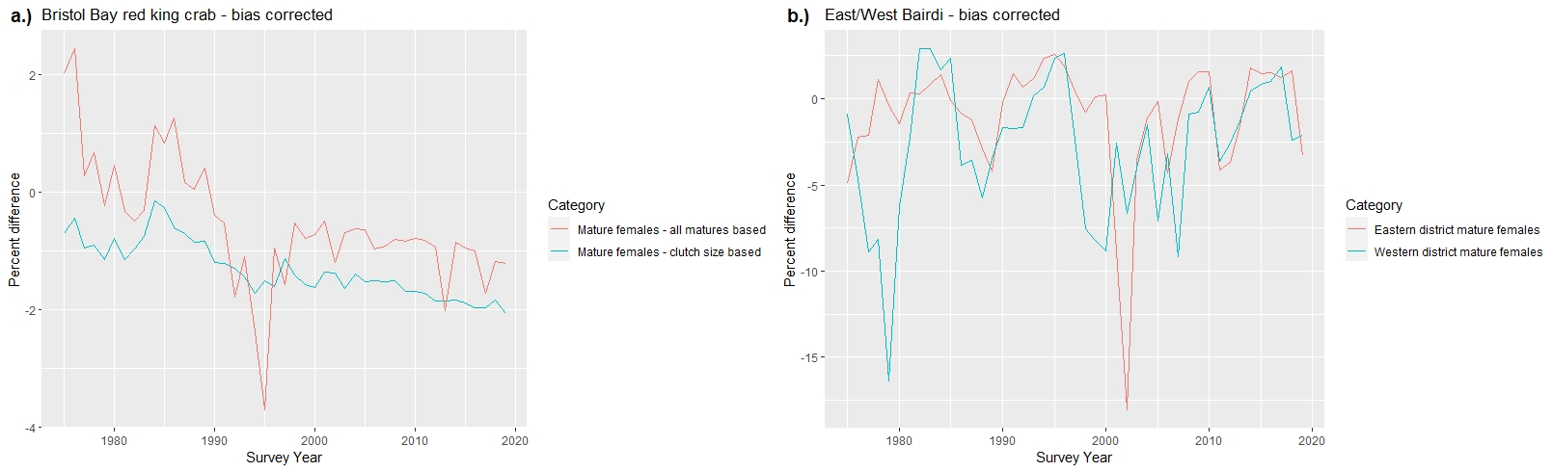
Females
CB: Ovigerity-based.
Barren females
Excluded from
mature S-W model
Notes:
For females, the new maturity and ovigerity based models for mature female Bristol Bay red king crab both demonstrate a a gradual decrease in estimated biomass relative to the baseline estimates. For the maturity based model a single relatively large-scale anomaly may be seen in 1995. I am currently assessing what drove this anomaly, but do not yet have an explanation.
For Bairdi, again biomass estimates derived using the new model parameters tended to be slightly smaller than the baseline estimates, with a single large anomaly observed in the both the eastern and western districts, although in different years (1979 in the west and 2002 in the east). Here again I am still ascertaining the exact cause of these anomalies, and would like to caution that the female findings are still very preliminary and may change.

Slide 25
Conclusions
Bias corrections
minimally affect parameters/model output
Shell condition
Minor effects (BBRKC, SMBKC, EBS CO)
SE (in new models ~ ½ to ¼ size of baseline)
EBS CB
Greater effect
OS
Statistical support for updating parameters is not there
OS Bairdi?
Notes:
In conclusion, bias correction, while important to procedural integrity, had minimal effects on model parameters and final output.
Shell condition had at best minor effects on most stocks investigated, with the exception of bairdi, where OS models were consistently statistically different from the current baseline.
Finally, with the possible exception of old shell bairdi, I do not believe at this time that there is robust statistical support for a general update of the size-weight model parameters along the lines investigated. Any decision to do so at this point would be dependent on how important relatively small to actually small changes in biomass, and modest improvements in parameter standard errors are judged to be.

Slide 26
Future work
Applying bias-correction procedures to current model parameters
Nonlinear models for L-W parameters
Avoid log-transformation
Finish female work
SMBKC
Investigate large anomalies
Investigate trends seen in BBRKC females
Temperature
Barren mature females
Notes:
In terms of future work, I will be applying bias correction procedures to baseline model parameters.
I will also be investigating non-linear modeling for estimating size weight parameters, to avoid log-transformation and bias correction.
Finally, there is still much work to be done with female size-weight models as even the work presented here was largely preliminary. The highest priority here is completing the female SMBKC analyses, with investigating the aforementioned large anomalies, and divergent trends in female BBRKC models, and completing temperature-based female models also being high priorities. Further in the future, I hope to model barren mature females separately.

Slide 27
Literature cited
Brodziak, J. 2012. Fitting length-weight relationships with linear regression using the log-transformed allometric model with bias-correction. Pacific Islands Fisheries Science Center Administrative Report H-12-03.
Chilton, E.A. 2009. Updates to size-weight relationships of eastern Bering Sea commercial crab species. Presentation.
Chilton, E.A. 2011. Size-weight relationships of commercial crab in the eastern Bering Sea.

Slide 28

Questions?

